Slide 1
Lucene
Section 2
Eng. Nesma Mahmoud

Slide 2
Remember: Lucene in a search system
1. indexing
Users
map the tokens into
indexes
Index document
Analyze document
convert the text into
tokens
Search UI
Index
2. Searching
Build document
Build query
Render results
Acquire content
Raw Content
Run query
Indexes storage: files, DB
Notes:
What is searching?
Take the user input
Create a query
Query the index
Return the results

Slide 3
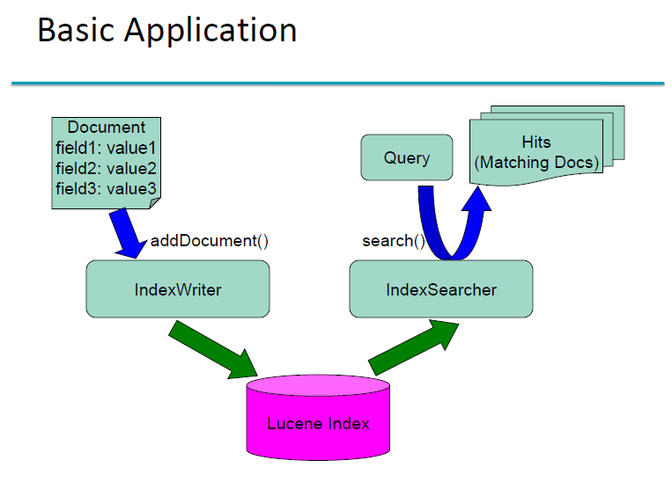

Slide 4
Remember: Lucene in a search system
1. indexing
Users
map the tokens into
indexes
Index document
3
Analyze document
convert the text into
tokens
Search UI
Index
2. Searching
2
Build document
Build query
Render results
1
Acquire content
Raw Content
Run query
Indexes storage: files, DB
Today focus
Notes:
What is searching?
Take the user input
Create a query
Query the index
Return the results

Slide 5
Acquire Raw Content
1
Acquire content
Raw Content
Acquire Raw Content:
aims at gathers and scopes the content that needs to be indexed.
done by a crawler (or spider or bot) because Lucene doesn’t support it
A Web crawler:
is a program that visits Web sites and reads their pages and other information in order to create entries for a search engine index.
Secured data
New or updated data
A number of open source crawlers are available:
Solr (based on Lucene)
Nutch (based on Lucene)
Droids (based on Lucene)
Grub
Notes:
Crawler will be useful if the content is scattered in all sorts of places (file systems, various websites, databases, local XML files, and so forth).
Web search engines and some other sites use Web crawling or spidering software to update their web content or indices of others sites' web content.

Slide 6
Lets code it ☺
Purpose:
Write a Lucene example that: (1) index a set of text files in a directory and
search on them
For complete code → lucene_sec2/src/lucene_for_txt_files

Slide 7
Remember
Lucene Implementation steps:
Get Lucene jar file (library) & add it to you Java project
Write indexing code
Write searching code
Write code to use/display results

Slide 8
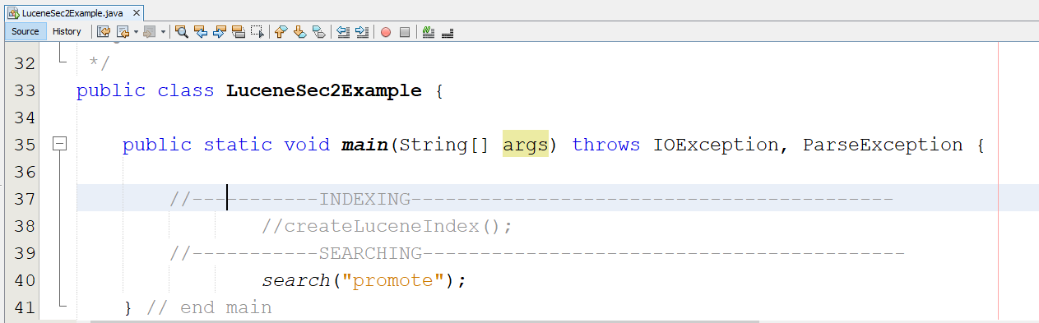
1. create a new class: inside this class, we will create two classes

Slide 9
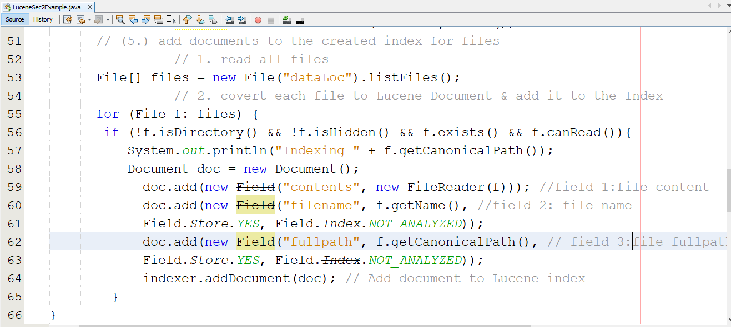
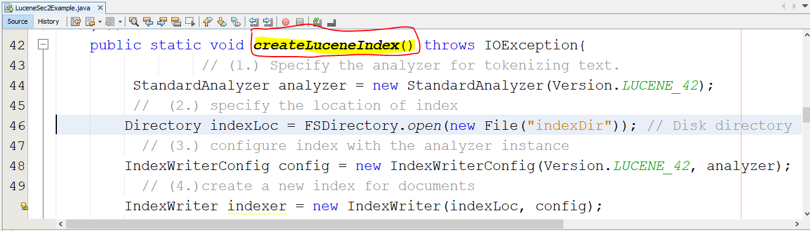
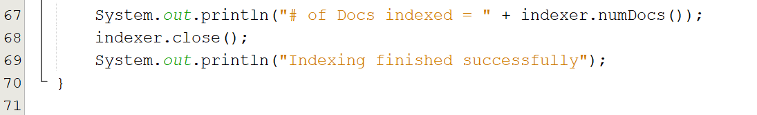
2. Implement the Indexing function

Slide 10
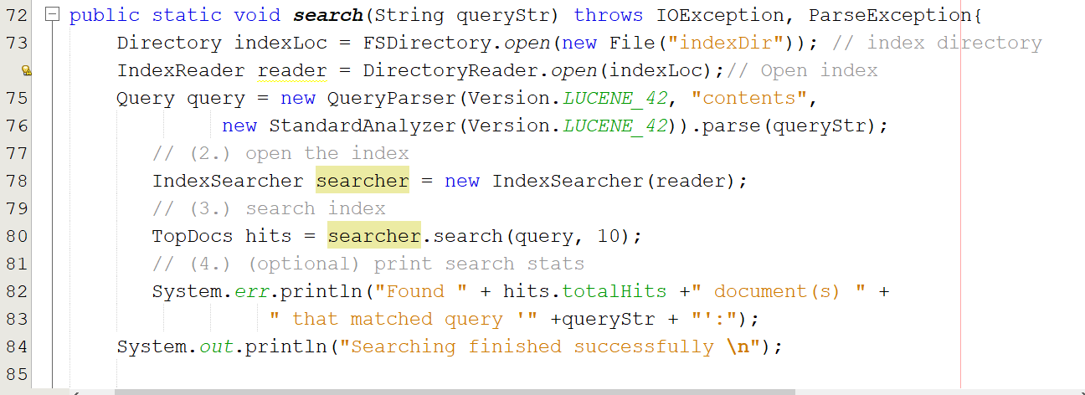
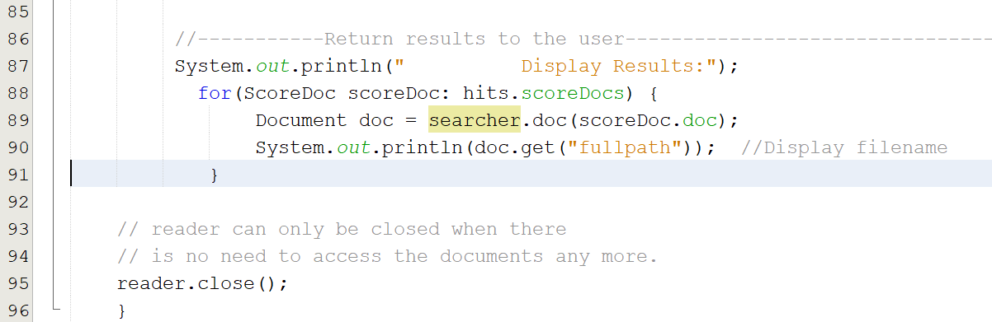
3. Implement the searching function & Display results

Slide 11
Build document
2
Build document
1
Acquire content
Raw Content
Build document:
covert the raw content to units (usually called documents) used by the
search engine.
The document
is the atomic unit of indexing and searching in Lucene
consists of several separately named fields with values that are searched at search time
Fields examples: title, body, abstract, author, and url.
Search example: users could search for “title:lucene” to find all documents whose title field value contains the term lucene.
You’ll have to carefully design how to divide the raw content into documents and fields as well as how to compute the value for each of those fields.
One email message becomes one document
One PDF file or web page is one document
Notes:
Once you’ve worked out this design, you’ll need to extract text from the original raw content for each document.
If your content is already textual in nature → your indexing job is simple.

Slide 12
More on Lucene Fields
Each field has:
Name: to identify it
Value: text or binary
Options: describe what Lucene should do with the field’s value when you add the document to the index.
Field has three options:
Index
This option: (1) tokenize the field’s value using the analyzer then (2) stored in the index
Use this option when will you search on the field value, otherwise, don’t index the field value
Store
Meaning a verbatim copy of the unanalyzed value is written away in the index so that it can later be retrieved.
Useful for fields that you’d like to display to users such as the document’s title or abstract
termVector (optionally)
miniature inverted index for the field, allowing you to retrieve all of its tokens
Useful for highlighting, finding similar documents, categorization

Slide 13
More on Lucene Fields: options
1. Index | 2. Store | 3. TermVector (optionally) | Example usage
NOT_ANALYZED | YES | NO | Identifiers, telephone/SSNs, URLs, dates, ...
ANALYZED | YES | WITH_POSITIONS_OFFSETS | Title, abstract
ANALYZED | NO | WITH_POSITIONS_OFFSETS | Body
NO | YES | NO | Document type, DB keys (if not used for searching)
NOT_ANALYZED | NO | NO | Hidden keywords
Examples:
Document doc = new Document();
doc.add(new Field("country", “Egypt”, Field.Store.YES, Field.Index.NO));
doc.add(new Field("city", “Cairo”, Field.Store.YES, Field.Index.ANALYZED));
doc.add(new Field("id", 1, Field.Store.YES, Field.Index.NOT_ANALYZED));
...

Slide 14
More on Lucene Fields: Multi-valued
When will you need multi-valued fields?
Suppose your documents have an author field, but sometimes there’s more than one author for a document
Lucene allows to add multiple Fields with the same name (multi-valued field)
Lucene simply concatenates the different values for that named Field
Example:
Document doc = new Document();
doc.add(new Field(“author”, “Nesma Mahmoud”, Field.Store.YES, Field.Index.ANALYZED));
doc.add(new Field(“author”, “Adel Mohamed”, Field.Store.YES, Field.Index.ANALYZED));
...

Slide 15
Analyze the document
3
Analyze document
2
Build document
1
Acquire content
Analyze:
Tokenizes the text.
Each token corresponds roughly to a “word” in the language
Common Analyzers in Lucene:
StandardAnalyzer
Most sophisticated analyzer that knows about certain token types, lowercases, removes stop words, ...
WhitespaceAnalyzer
Splits tokens on whitespace
SimpleAnalyzer
Splits tokens on non-letters, and then lowercases
StopAnalyzer
Same as SimpleAnalyzer, but also removes stop words
KeywordAnalyzer
Treats the entire text as a single token.
Raw Content

Slide 16
Analyzers – example 1
Text: “XY&Z Corporation – xyz@example.com”
WhitespaceAnalyzer
[XY&Z] [Corporation] [-] [xyz@example.com]
SimpleAnalyzer
[xy] [z] [corporation] [xyz] [example] [com]
StopAnalyzer
[xy] [z] [corporation] [xyz] [example] [com]
StandardAnalyzer
[xy&z] [corporation] [xyz@example.com]

Slide 17
Analyzers – example 2
Text: “The quick brown fox jumped over the lazy dog”
WhitespaceAnalyzer
[The] [quick] [brown] [fox] [jumped] [over] [the] [lazy] [dog]
SimpleAnalyzer
[the] [quick] [brown] [fox] [jumped] [over] [the] [lazy] [dog]
StopAnalyzer
[quick] [brown] [fox] [jumped] [over] [lazy] [dog]
StandardAnalyzer
[quick] [brown] [fox] [jumped] [over] [lazy] [dog]

Slide 18
Analyzers – more
StopAnalyzer:
Stop words: "a", "an", "and", "are", "as", "at", "be", "but", "by", "for", "if", "in", "into", "is", "it", "no", "not", "of", "on", "or", "such", "that", "the", "their", "then", "there", "these", "they", "this", "to", "was", "will", "with"
The StopAnalyzer has a second constructor that allows you to pass your own set instead.
StopAnalyzer creates a StopFilter to perform the filtering.
StandardAnalyzer:
The most generally useful built-in analyzer and makes a great first choice.
alphanumerics, acronyms, company names, email addresses, computer hostnames, numbers, words with an interior apostrophe, serial numbers, IP addresses, and Chinese and Japanese characters.

Slide 19
Lets code it ☺
Purpose:
Explore Lucene analyzers
For complete code → lucene_sec2/src/lucene_analyzers

Slide 20
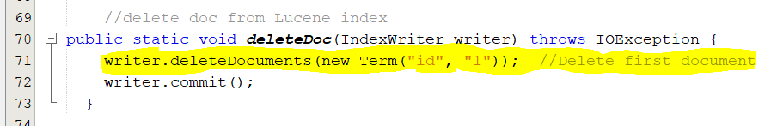
Index Management
Deleting documents from an index
IndexWriter provides various methods to remove documents from an index:
deleteDocuments(Term):
deletes all documents containing the provided term.

Slide 21
Index Management
Deleting documents: other methods
deleteDocuments(Term[]):
deletes all documents containing any of the terms in the provided array.
deleteDocuments(Query):
deletes all documents matching the provided query.
deleteDocuments(Query[]):
deletes all documents matching any of the queries in the provided array.
deleteAll():
deletes all documents in the index

Slide 22
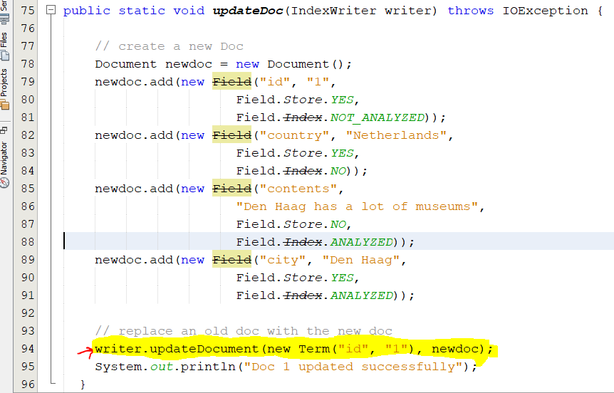
Index Management
Updating documents in the index
updateDocument(Term, Document):
(1) first deletes all documents containing the provided term and then (2) adds the new document using the writer’s default analyzer.
updateDocument(Term, Document, Analyzer):
does the same but uses the provided analyzer instead of the writer’s default analyzer.
Example:

Slide 23
Lets code it ☺
Purpose:
Explore Lucene analyzers
For complete code → lucene_sec2/src/lucene_indx_mng

